Slide 1
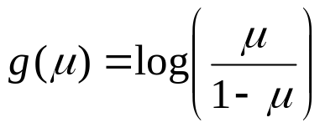
Logistic Regression
Logistic Regression - Dichotomous Response variable and numeric and/or categorical explanatory variable(s)
  Goal: Model the probability of a particular as a function of the predictor variable(s)
  Problem: Probabilities are bounded between 0 and 1
Distribution of Responses: Binomial
Link Function:

Slide 2
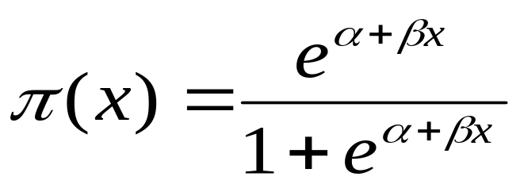
Logistic Regression with 1 Predictor
Response - Presence/Absence of characteristic
Predictor - Numeric variable observed for each case
Model - π(x) ≡ Probability of presence at predictor level x
β = 0 ⇒ P(Presence) is the same at each level of x
β > 0 ⇒ P(Presence) increases as x increases
β < 0 ⇒ P(Presence) decreases as x increases

Slide 3
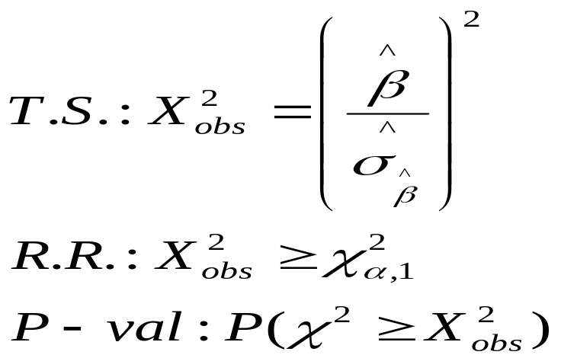
Logistic Regression with 1 Predictor
α, β are unknown parameters and must be estimated using statistical software such as SPSS, SAS, or STATA
Primary interest in estimating and testing hypotheses regarding β
  Large-Sample test (Wald Test):
  H₀: β = 0 H_{A}: β ≠ 0

Slide 4
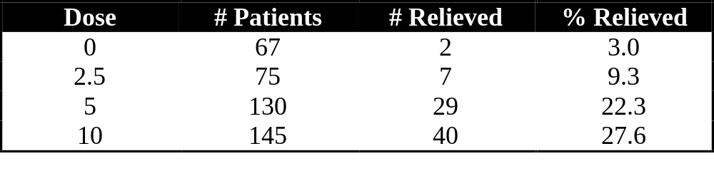
Example - Rizatriptan for Migraine
Response - Complete Pain Relief at 2 hours (Yes/No)
Predictor - Dose (mg): Placebo (0),2.5,5,10

Slide 5
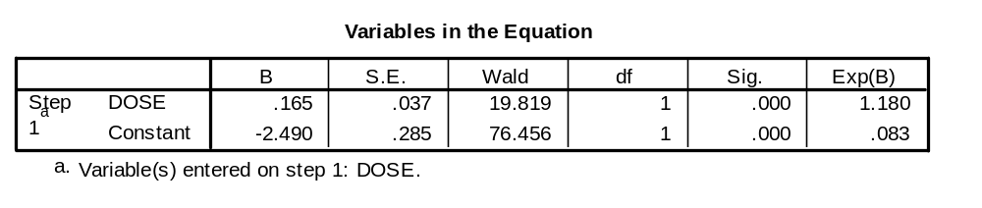
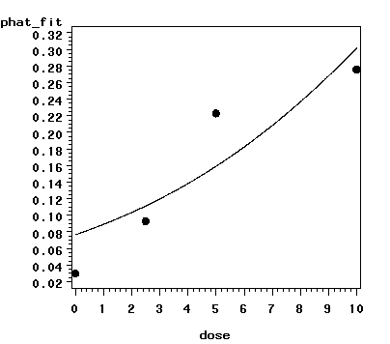
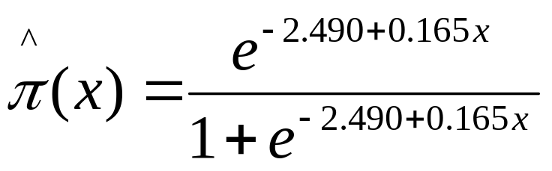
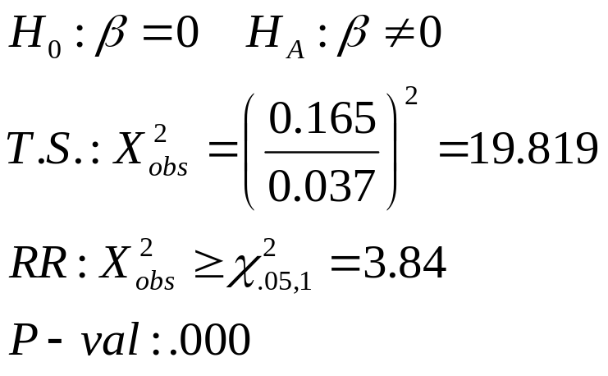
Example - Rizatriptan for Migraine (SPSS)

Slide 6
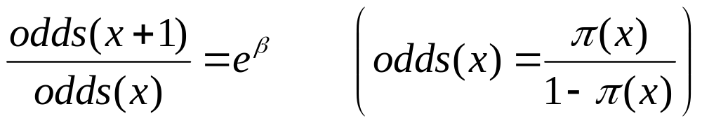
Odds Ratio
Interpretation of Regression Coefficient (β):
  In linear regression, the slope coefficient is the change in the mean response as x increases by 1 unit
  In logistic regression, we can show that:
Thus e^{β} represents the change in the odds of the outcome (multiplicatively) by increasing x by 1 unit
If β = 0, the odds and probability are the same at all x levels (e^{β}=1)
If β > 0 , the odds and probability increase as x increases (e^{β}>1)
If β < 0 , the odds and probability decrease as x increases (e^{β}<1)

Slide 7
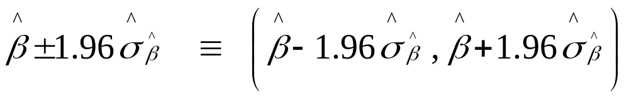
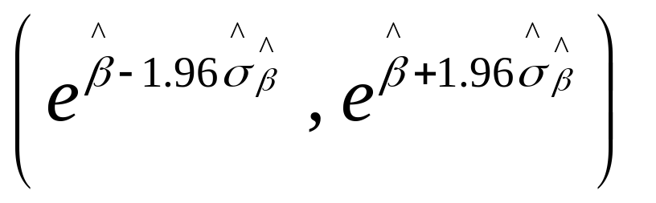
95% Confidence Interval for Odds Ratio
Step 1: Construct a 95% CI for β :
Step 2: Raise e = 2.718 to the lower and upper bounds of the CI:
If entire interval is above 1, conclude positive association
If entire interval is below 1, conclude negative association
If interval contains 1, cannot conclude there is an association

Slide 8
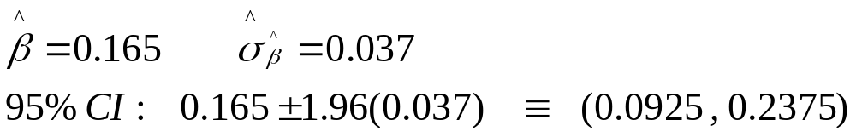
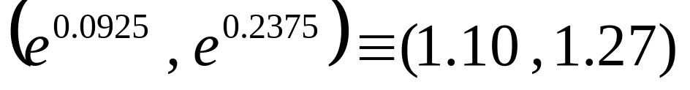
Example - Rizatriptan for Migraine
95% CI for β :
95% CI for population odds ratio:
Conclude positive association between dose and probability of complete relief

Slide 9
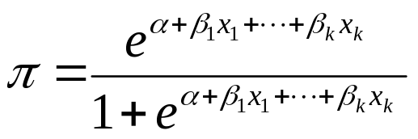
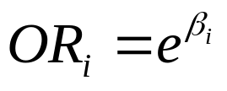
Multiple Logistic Regression
Extension to more than one predictor variable (either numeric or dummy variables).
With k predictors, the model is written:
Adjusted Odds ratio for raising x_{i} by 1 unit, holding all other predictors constant:
Many models have nominal/ordinal predictors, and widely make use of dummy variables

Slide 10
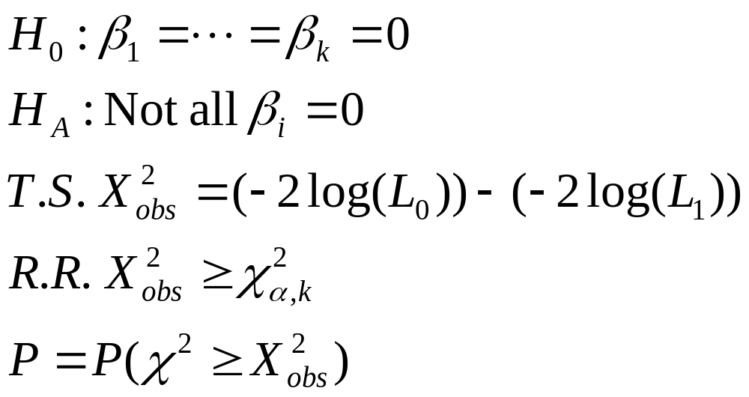
Testing Regression Coefficients
Testing the overall model:
L₀, L₁ are values of the maximized likelihood function, computed by statistical software packages. This logic can also be used to compare full and reduced models based on subsets of predictors. Testing for individual terms is done as in model with a single predictor.

Slide 11
Example - ED in Older Dutch Men
Response: Presence/Absence of ED (n=1688)
Predictors: (p=12)
  Age stratum (50-54*, 55-59, 60-64, 65-69, 70-78)
  Smoking status (Nonsmoker*, Smoker)
  BMI stratum (<25*, 25-30, >30)
  Lower urinary tract symptoms (None*, Mild, Moderate, Severe)
  Under treatment for cardiac symptoms (No*, Yes)
  Under treatment for COPD (No*, Yes)
    * Baseline group for dummy variables

Slide 12
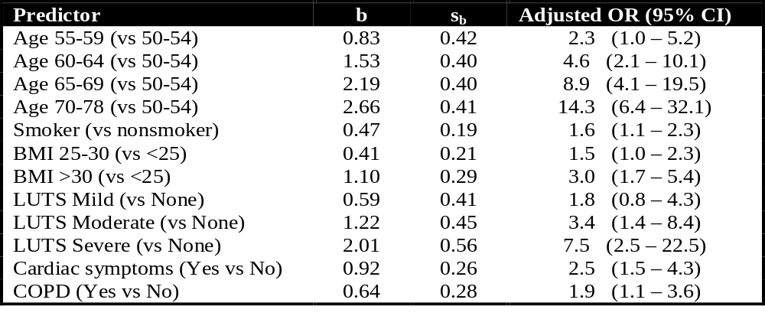
Example - ED in Older Dutch Men
Interpretations: Risk of ED appears to be:
  Increasing with age, BMI, and LUTS strata
  Higher among smokers
  Higher among men being treated for cardiac or COPD

Slide 13
Loglinear Models with Categorical Variables
Logistic regression models when there is a clear response variable (Y), and a set of predictor variables (X₁,...,X_{k})
In some situations, the variables are all responses, and there are no clear dependent and independent variables
Loglinear models are to correlation analysis as logistic regression is to ordinary linear regression

Slide 14
Loglinear Models
Example: 3 variables (X,Y,Z) each with 2 levels
Can be set up in a 2x2x2 contingency table
Hierarchy of Models:
  All variables are conditionally independent
  Two of the pairs of variables are conditionally independent
  One of the pairs are conditionally independent
  No pairs are conditionally independent, but each association is constant across levels of third variable (no interaction or homogeneous association)
  All pairs are associated, and associations differ among levels of third variable

Slide 15
Loglinear Models
To determine associations, must have a measure: the odds ratio (OR)
Odds Ratios take on the value 1 if there is no association
Loglinear models make use of regressions with coefficients being exponents. Thus, tests of whether odds ratios are 1, is equivalently to testing whether regression coefficients are 0 (as in logistic regression)
For a given partial table, OR=e^{β}, software packages estimate and test whether β=0

Slide 16
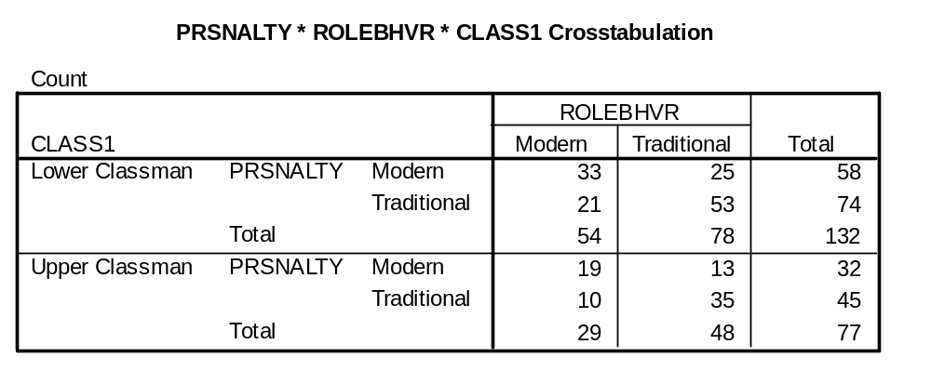
Example - Feminine Traits/Behavior
3 Variables, each at 2 levels (Table contains observed counts):
  Feminine Personality Trait (Modern/Traditional)
  Female Role Behavior (Modern/Traditional)
  Class (Lower Classman/Upper Classman)

Slide 17
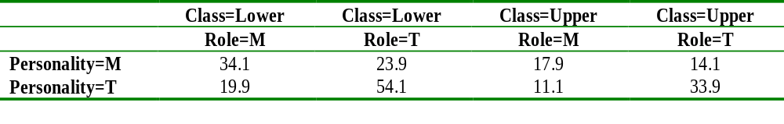
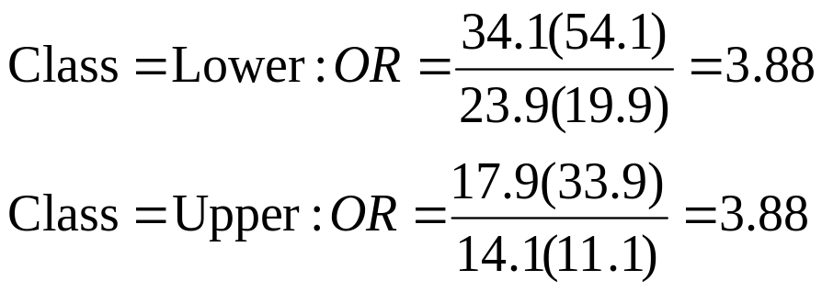
Example - Feminine Traits/Behavior
Expected cell counts under model that allows for association among all pairs of variables, but no interaction (association between personality and role is same for each class, etc). Model:(PR,PC,RC)
  Evidence of personality/role association (see odds ratios)
Note that under the no interaction model, the odds ratios measuring the personality/role association is same for each class

Slide 18
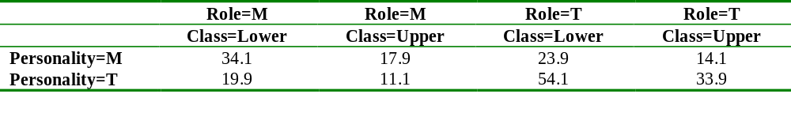
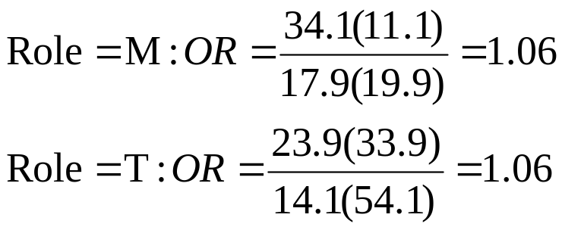
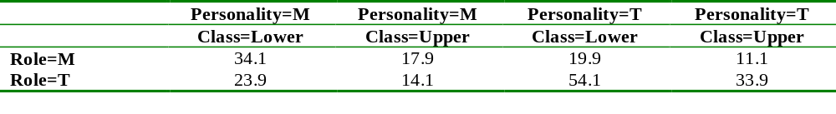
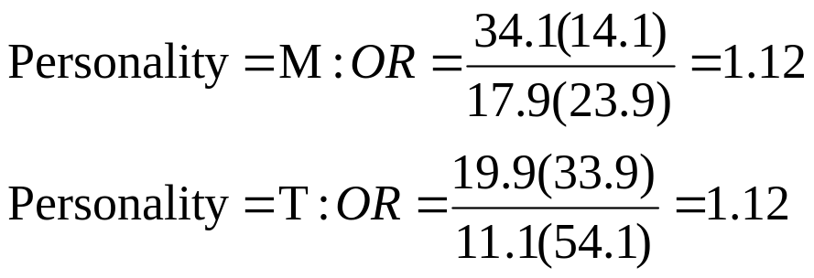
Example - Feminine Traits/Behavior

Slide 19
Example - Feminine Traits/Behavior
Intuitive Results:
  Controlling for class in school, there is an association between personality trait and role behavior (OR_{Lower}=OR_{Upper}=3.88)
  Controlling for role behavior there is no association between personality trait and class (OR_{Modern}= OR_{Traditional}=1.06)
  Controlling for personality trait, there is no association between role behavior and class (OR_{Modern}= OR_{Traditional}=1.12)

Slide 20
SPSS Output
Statistical software packages fit regression type models, where the regression coefficients for each model term are the log of the odds ratio for that term, so that the estimated odds ratio is e raised to the power of the regression coefficient.
Parameter Estimates
Asymptotic 95% CI
Parameter Estimate SE Z-value Lower Upper
Constant 3.5234 .1651 21.35 3.20 3.85
Class .4674 .2050 2.28 .07 .87
Personality -.8774 .2726 -3.22 -1.41 -.34
Role -1.1166 .2873 -3.89 -1.68 -.55
C*P .0605 .3064 .20 -.54 .66
C*R .1166 .3107 .38 -.49 .73
R*P 1.3554 .2987 4.54 .77 1.94
Note: e^{1.3554} = 3.88 e^{.0605} = 1.06 e^{.1166} = 1.12

Slide 21
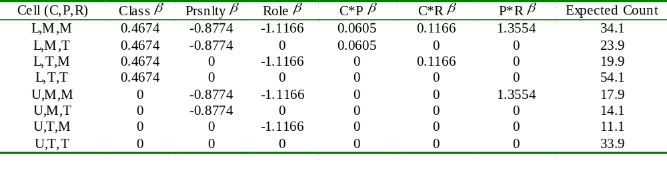
Interpreting Coefficients
The regression coefficients for each variable corresponds to the lowest level (in alphanumeric ordering of symbols). Computer output will print a “mapping” of coefficients to variable levels.
To obtain the expected cell counts, add the constant (3.5234) to each of the β^{s} for that row, and raise e to the power of that sum

Slide 22
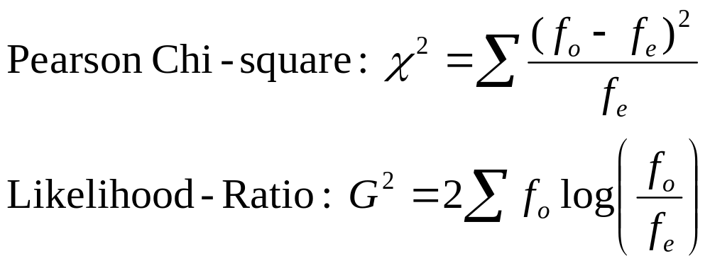
Goodness of Fit Statistics
For any logit or loglinear model, we will have contingency tables of observed (f_{o}) and expected (f_{e}) cell counts under the model being fit.
Two statistics are used to test whether a model is appropriate: the Pearson chi-square statistic and the likelihood ratio (aka Deviance) statistic

Slide 23
Goodness of Fit Tests
Null hypothesis: The current model is appropriate
Alternative hypothesis: Model is more complex
Degrees of Freedom: Number of sample logits-Number of parameters in model
Distribution of Goodness of Fit statistics under the null hypothesis is chi-square with degrees of freedom given above
Statistical software packages will print these statistics and P-values.

Slide 24
Example - Feminine Traits/Behavior
Table Information
Observed Expected
Factor Value Count % Count %
PRSNALTY Modern
ROLEBHVR Modern
CLASS1 Lower Classman 33.00 ( 15.79) 34.10 ( 16.32)
CLASS1 Upper Classman 19.00 ( 9.09) 17.90 ( 8.57)
ROLEBHVR Traditional
CLASS1 Lower Classman 25.00 ( 11.96) 23.90 ( 11.44)
CLASS1 Upper Classman 13.00 ( 6.22) 14.10 ( 6.75)
PRSNALTY Traditional
ROLEBHVR Modern
CLASS1 Lower Classman 21.00 ( 10.05) 19.90 ( 9.52)
CLASS1 Upper Classman 10.00 ( 4.78) 11.10 ( 5.31)
ROLEBHVR Traditional
CLASS1 Lower Classman 53.00 ( 25.36) 54.10 ( 25.88)
CLASS1 Upper Classman 35.00 ( 16.75) 33.90 ( 16.22)
Goodness-of-fit Statistics
Chi-Square DF Sig.
Likelihood Ratio .4695 1 .4932
Pearson .4664 1 .4946

Slide 25
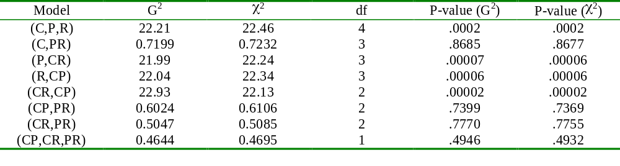
Example - Feminine Traits/Behavior
Goodness of fit statistics/tests for all possible models:
The simplest model for which we fail to reject the null hypothesis that the model is adequate is: (C,PR): Personality and Role are the only associated pair.

Slide 26
Adjusted Residuals
Standardized differences between actual and expected counts (f_{o}-f_{e}, divided by its standard error).
Large adjusted residuals (bigger than 3 in absolute value, is a conservative rule of thumb) are cells that show lack of fit of current model
Software packages will print these for logit and loglinear models

Slide 27
Example - Feminine Traits/Behavior
Adjusted residuals for (C,P,R) model of all pairs being conditionally independent:
Adj.
Factor Value Resid. Resid.
PRSNALTY Modern
ROLEBHVR Modern
CLASS1 Lower Classman 10.43 3.04**
CLASS1 Upper Classman 5.83 1.99
ROLEBHVR Traditional
CLASS1 Lower Classman -9.27 -2.46
CLASS1 Upper Classman -6.99 -2.11
PRSNALTY Traditional
ROLEBHVR Modern
CLASS1 Lower Classman -8.85 -2.42
CLASS1 Upper Classman -7.41 -2.32
ROLEBHVR Traditional
CLASS1 Lower Classman 7.69 1.93
CLASS1 Upper Classman 8.57 2.41

Slide 28
Comparing Models with G² Statistic
Comparing a series of models that increase in complexity.
Take the difference in the deviance (G²) for the models (less complex model minus more complex model)
Take the difference in degrees of freedom for the models
Under hypothesis that less complex (reduced) model is adequate, difference follows chi-square distribution

Slide 29
Example - Feminine Traits/Behavior
Comparing a model where only Personality and Role are associated (Reduced Model) with the model where all pairs are associated with no interaction (Full Model).
Reduced Model (C,PR): G²=.7232, df=3
Full Model (CP,CR,PR): G²=.4695, df=1
Difference: .7232-.4695=.2537, df=3-1=2
Critical value (α=0.05): 5.99
Conclude Reduced Model is adequate

Slide 30
Logit Models for Ordinal Responses
Response variable is ordinal (categorical with natural ordering)
Predictor variable(s) can be numeric or qualitative (dummy variables)
Labeling the ordinal categories from 1 (lowest level) to c (highest), can obtain the cumulative probabilities:

Slide 31
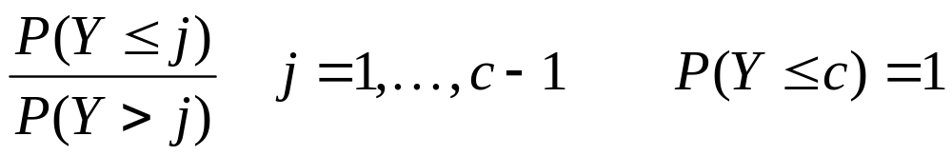
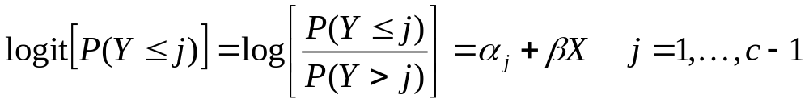
Logistic Regression for Ordinal Response
The odds of falling in category j or below:
Logit (log odds) of cumulative probabilities are modeled as linear functions of predictor variable(s):
This is called the proportional odds model, and assumes the effect of X is the same for each cumulative probability

Slide 32
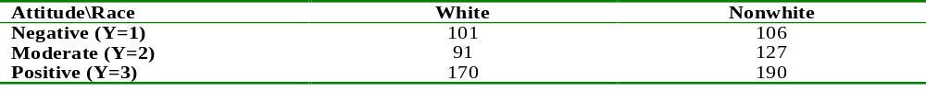
Example - Urban Renewal Attitudes
Response: Attitude toward urban renewal project (Negative (Y=1), Moderate (Y=2), Positive (Y=3))
Predictor Variable: Respondent’s Race (White, Nonwhite)
Contingency Table:

Slide 33
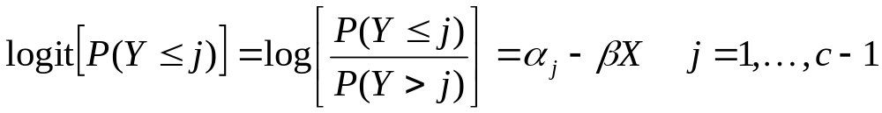
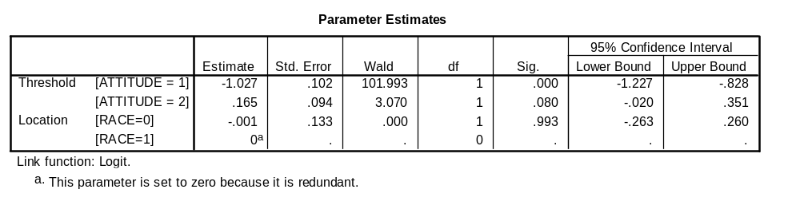
SPSS Output
Note that SPSS fits the model in the following form:
Note that the race variable is not significant (or even close).

Slide 34
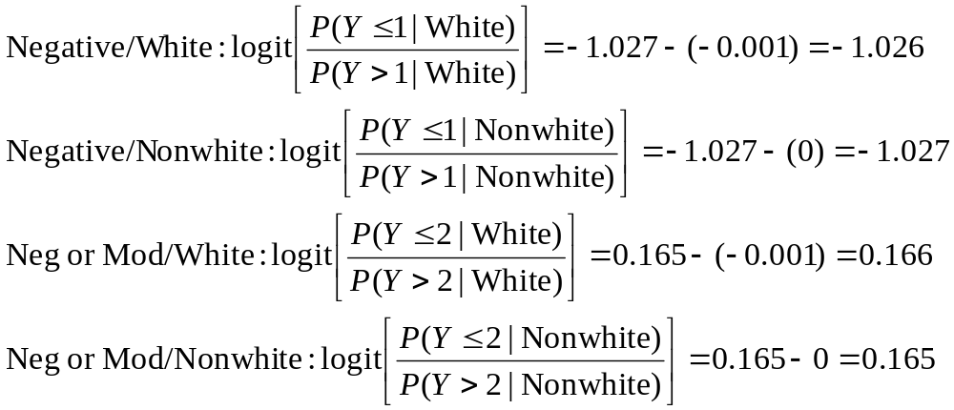
Fitted Equation
The fitted equation for each group/category:
For each group, the fitted probability of falling in that set of categories is e^{L}/(1+e^{L}) where L is the logit value (0.264,0.264,0.541,0.541)

Slide 35
Inference for Regression Coefficients
If β = 0, the response (Y) is independent of X
Z-test can be conducted to test this (estimate divided by its standard error)
Most software will conduct the Wald test, with the statistic being the z-statistic squared, which has a chi-squared distribution with 1 degree of freedom under the null hypothesis
Odds ratio of increasing X by 1 unit and its confidence interval are obtained by raising e to the power of the regression coefficient and its upper and lower bounds

Slide 36
Example - Urban Renewal Attitudes
Z-statistic for testing for race differences:
Z=0.001/0.133 = 0.0075 (recall model estimates -β)
Wald statistic: .000 (P-value=.993)
Estimated odds ratio: e^{.001} = 1.001
95% Confidence Interval: (e^{-.260},e^{.263})=(0.771,1.301)
Interval contains 1, odds of being in a given category or below is same for whites as nonwhites

Slide 37
Ordinal Predictors
Creating dummy variables for ordinal categories treats them as if nominal
To make an ordinal variable, create a new variable X that models the levels of the ordinal variable
Setting depends on assignment of levels (simplest form is to let X=1,...,c for the categories which treats levels as being equally spaced)

